Slide 1
DEV JATINBHAI PATEL
CE076
20CEUOS018
DBMS LAB6

Slide 2
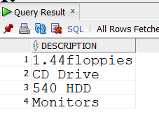
Find out the product which has been sold to ‘Ivan’
SELECT DISTINCT p.description FROM client_master c
JOIN sales_order so ON c.client_no = so.client_no AND c.name =
'Ivan'
JOIN sales_order_details sod ON so.s_order_no = sod.s_order_no
JOIN product_master p ON sod.product_no = p.product_no;

Slide 3
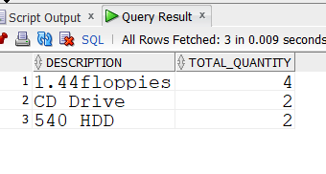
2. Find out the product and their quantities that will have to be
delivered in the January month.
SELECT DISTINCT p.description,
SUM(sod.qty_order)TOTAL_QUANTITY FROM sales_order_details
sod
JOIN sales_order so ON so.s_order_no = sod.s_order_no
AND so.dely_date between date ‘1996-01-01’ and date ‘1996-01-31’
JOIN product_master p ON sod.product_no = p.product_no
AND sod.qty_disp != 0
GROUP BY (p.description);

Slide 4
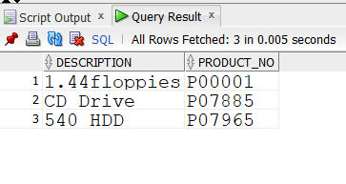
3.Find the product_no and description of moving products.
SELECT DISTINCT p.description , p.product_no from product_master p
join sales_order_details sod on sod.qty_disp != '0' and sod.product_no = p.product_no
join sales_order so on so.order_status = 'in process' and so.s_order_no = sod.s_order_no;
select * from sales_order;

Slide 5
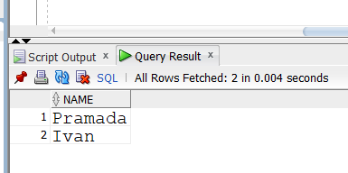
4.Find out the names of clients who have purchased ‘CD DRIVE’.
select c.name from client_master c join sales_order so on c.client_no = so.client_no join sales_order_details sod on
sod.s_order_no = so.s_order_no join product_master pm on pm.product_no = sod.product_no where pm .description = 'CD Drive';

Slide 6
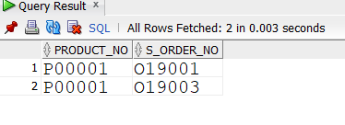
5.List the product_no and s_order_no of customers having qty ordered less than 5
from the order details table for the product “1.44 floppies”.
select sod.product_no , sod.s_order_no from sales_order_details sod join product_master pm on
sod.product_no = pm.product_no and sod.qty_order < 5 and pm.description
='1.44floppies';

Slide 7
6.Find the products and their quantities for the orders placed by
‘Vandana’ and ‘Ivan’.
select p.description,sum(sod.Qty_order) as Quantity from
sales_order so join client_master c on
so.client_no = c.client_no AND (c.name = 'Ivan' OR c.name =
'Vandana')
join sales_order_details sod on sod.s_order_no = so.s_order_no
join product_master p on p.product_no = sod.product_no group
by(p.description);

Slide 8
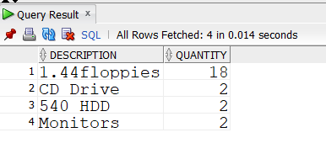
7. Find the products and their quantities for the orders placed by client_no ‘C00001’ and ‘C00002’.
select p.description, SUM(sod.qty_order) as Quantity from sales_order so join client_master c on so.client_no in('0001','0002') And so.client_no = c.client_no join sales_order_details sod on sod.s_order_no = so.s_order_no join product_master p on p.product_no = sod.product_no group by(p.description);

Slide 9
8. Find Client No. and count of salesman No. where a client has been
received by more than one salesman.
SELECT
TRIM(LEADING '0' FROM c.client_no) client_no,
COUNT(DISTINCT so.salesman_no) FROM client_master c
JOIN sales_order so ON c.client_no = so.client_no
GROUP BY (c.client_no);

Slide 10
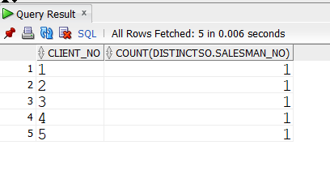
9.Display the s_order_date in the format “dd-mm-yy” e.g. “12- feb96”.
SELECT TO_CHAR(order_date,'DD-MON-YY')FROM sales_order;

Slide 11
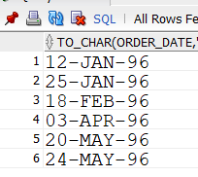
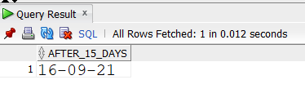
10.Find the date, 15 days after the current date.
SELECT SYSDATE + 15 after_15_days FROM dual;

Slide 12
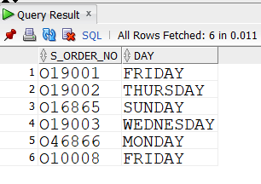
11. List the order number and day on which clients placed their
order.
Select so.s_order_no ,to_char(so.order_date ,'DAY') DAY FROM
sales_order so join client_master c on c.client_no = so.client_no ;

Slide 13
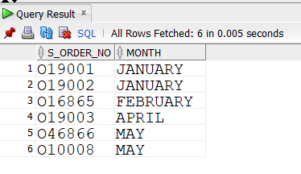
12. List the month (in alphabets) and date when the order must be
delivered.
Select so.s_order_no ,to_char(so.dely_date ,'MONTH') MONTH
FROM sales_order so join client_master c on c.client_no =
so.client_no ;

